Slide 1
Practice 4
Yao zhao

Slide 2
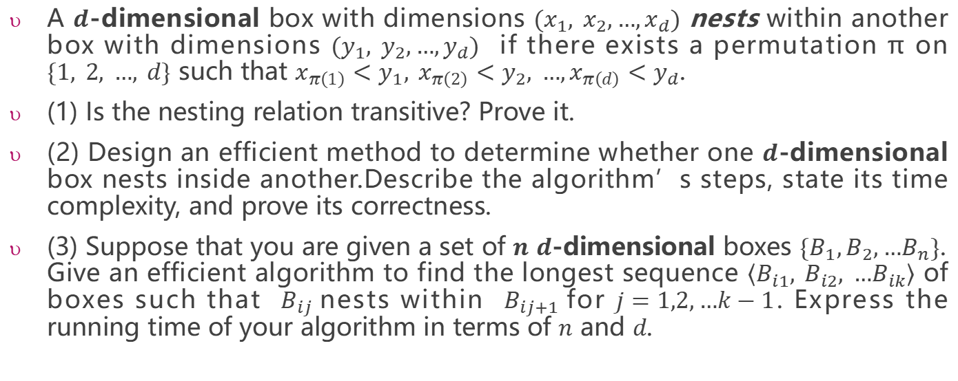
Nesting boxes
A $d$-dimensional box with dimensions $(x_{1}, x_{2},…,x_{d})$ nests within another box with dimensions $(y_{1}, y_{2},…,y_{d})$ if there exists a permutation π on $\{1, 2, …, d\}$ such that $x_{π\left(1\right)}<y_{1}, x_{π\left(2\right)}<y_{2}, …,x_{π\left(d\right)}<y_{d}$.
(1) Is the nesting relation transitive? Prove it.
(2) Design an efficient method to determine whether one $d$-dimensional box nests inside another.Describe the algorithm’s steps, state its time complexity, and prove its correctness.
(3) Suppose that you are given a set of $n$ $d$-dimensional boxes $\{B_{1},B_{2},…B_{n}\}$. Give an efficient algorithm to find the longest sequence $\left\langle B_{i1}, B_{i2}, …B_{ik}\right\rangle$ of boxes such that $B_{ij}$nests within $B_{ij+1}$for $j=1,2,…k−1$. Express the running time of your algorithm in terms of $n$ and $d$.

Slide 3
This week's practice does not require writing code. Instead, you need to describe the algorithmic steps (or provide pseudocode) and clearly explain the proof process.
Expected Output:
A structured algorithm description (or pseudocode).
A formal correctness proof (e.g., by induction, contradiction, or logical reasoning).
The practice will be checked in this lab class or the next lab class(before Apr.13) by teachers or SAs.
This practice will contribute 1 mark to your overall grade. Late submissions within 2 weeks after the deadline (before Apr.27)will incur a 20% penalty, meaning that you can only get 80% of the score.

